Slide 1
Module 15: Implement Cloud Infrastructure Monitoring
Azure Monitor, Azure Workbooks, Log Analytics, Network Watcher, and Azure Service Health

Slide 2

Learning Objectives
You will learn the following:
Azure Infrastructure Security Monitoring
Azure Monitor
Azure Workbooks
Azure Alerts
Log Analytics
Network Watcher
Azure Service Health
Azure Application Insights
Unified Monitoring in Azure
Monitor Azure Costs

Slide 3

Azure Infrastructure Security Monitoring

Slide 4

Azure Infrastructure Monitoring
Configuration and change management
Vulnerability management
Vulnerability scanning
Protective monitoring
Incident management

Slide 5

Security Posture
Strengthen your security posture:
Have a proactive strategy that audits your resources
View the security state of resources and any issues per resource type:
Monitor computer resources and apps
Monitor network resources
Monitor data and storage resources
Monitor you identity and access resources

Slide 6
Azure Monitor

Slide 7
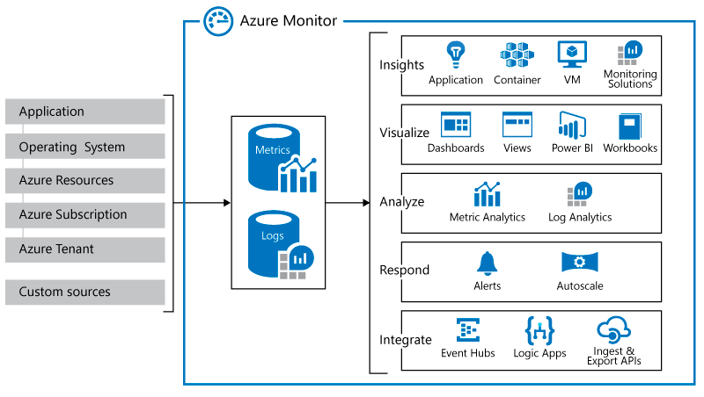
Azure Monitor service

Slide 8
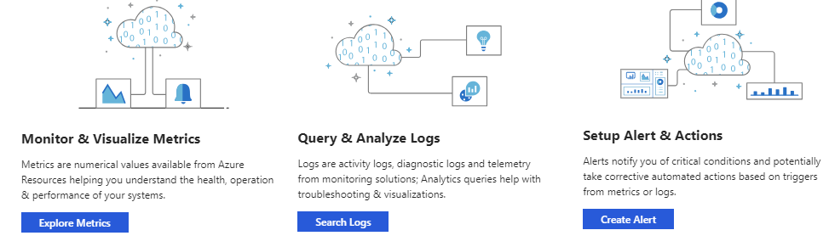
Key Capabilities
Monitor and visualize metrics
Query an analyze logs
Setup alerts and actions

Slide 9
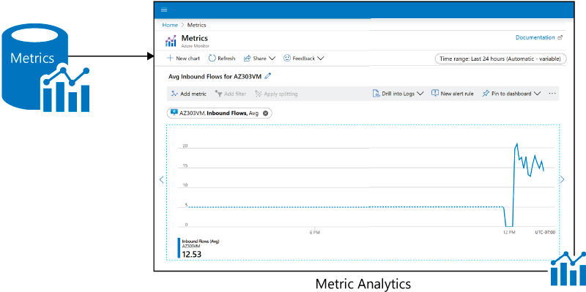
Monitoring Data Platform
Azure Monitor collects two types of data
Metrics
Logs

Slide 10
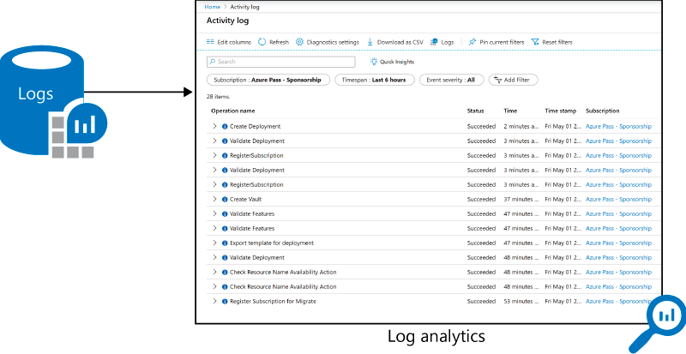
Log Data
Log data collected by Azure Monitor is stored in Log Analytics

Slide 11
Data Types
Azure Monitor collects data from each of the following tiers:
Azure subscription monitoring data
Application monitoring data
Guest OS monitoring data
Azure resource monitoring data
Azure tenant monitoring data

Slide 12
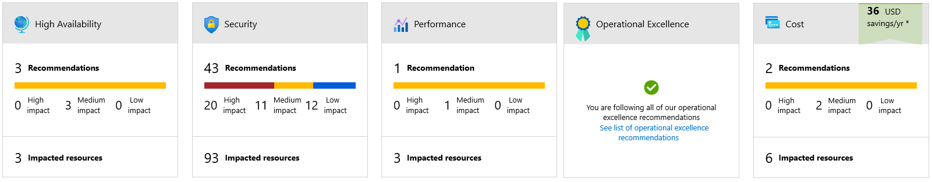
Azure Advisor
Azure Advisor is a personalized cloud consultant

Slide 13
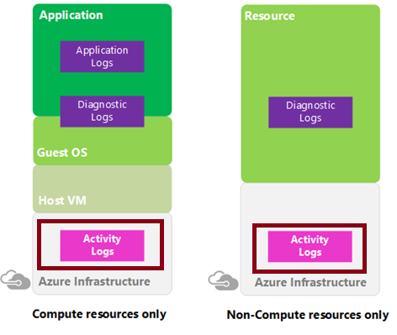
Activity Log
Azure Activity Log is a subscription log that provides insight into subscription-level events that have occurred in Azure
Through activity logs, you can determine:
What operations (PUT, POST, DELETE) were taken on all resources
Who started the operation
When the operation occurred
The status of the operation
The values of other properties that might help you research the operation

Slide 14
Query the Activity Log (1 of 2)
In the Azure portal, you can filter the Activity log by:
Subscription
Timespan
Event severity
Resource group
Resource (name)
Resource type
Operation name
Event initiated by
Search

Slide 15
Query the Activity Log (2 of 2)
Event categories:
Administrative
Service health
Resource health
Alert
Autoscale
Recommendation
Security
Policy

Slide 16
Azure Workbooks

Slide 17
Azure Workbooks Overview (1 of 2)
Workbooks provide a flexible canvas for data analysis and the creation of rich visual reports within the Azure portal
The rely on a wide range of data sources
Logs
Metrics
Azure Resource Graph
Alerts (preview)
Workload health (preview)
Azure Resource Health (preview)
Azure Data Explorer (preview)
Workbooks support different visualization types
Text
Charts
Grids
Tiles
Trees
Graphs

Slide 18
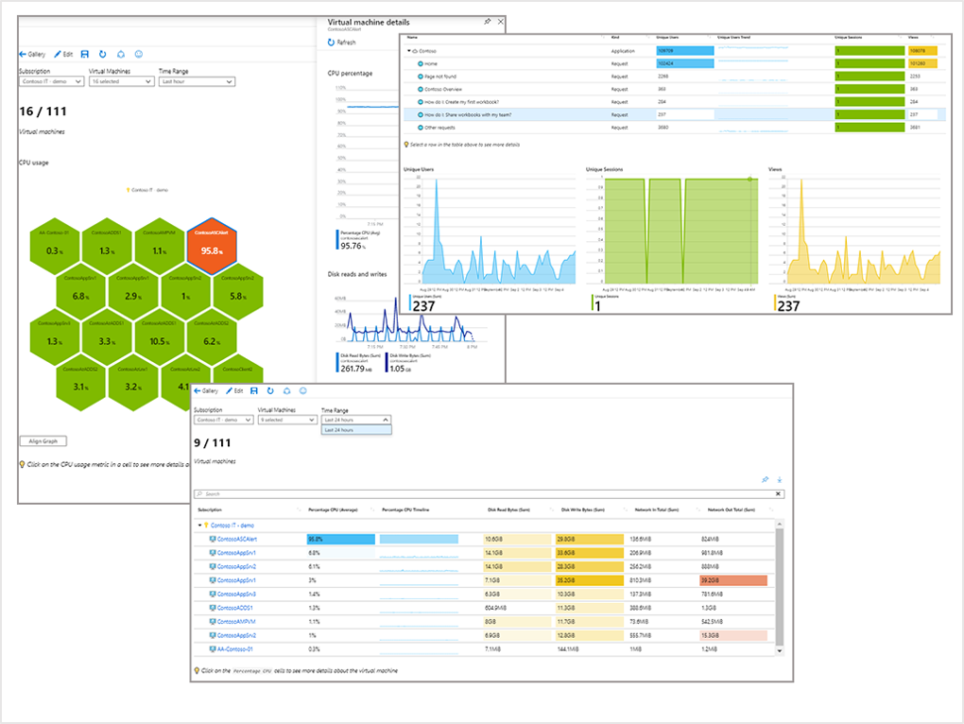
Azure Workbooks Overview (2 of 2)

Slide 19
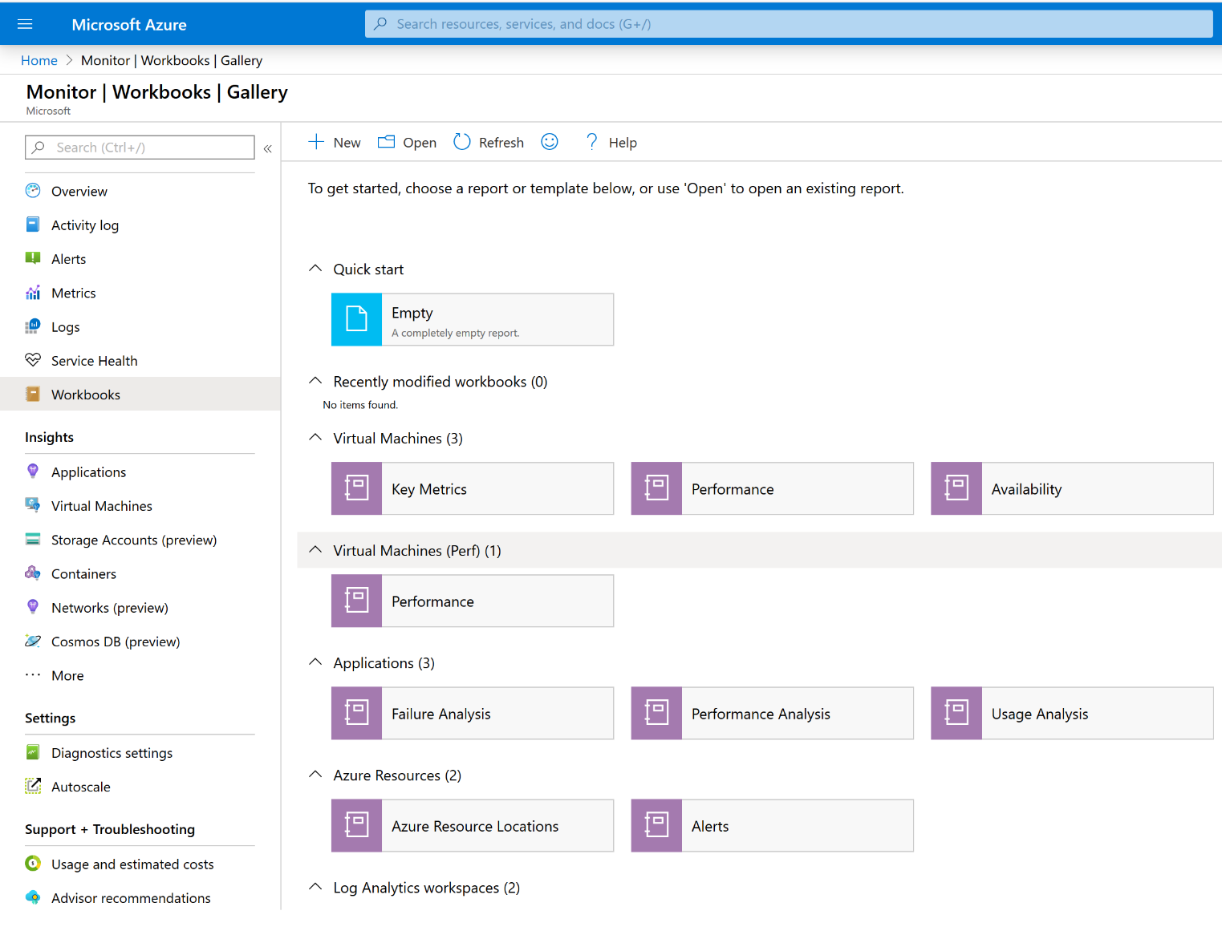
Using Azure Workbooks (1 of 2)
You can navigate to the workbook gallery from the Azure Monitor blade in the Azure portal
The gallery contains:
Workbooks
Workbook templates

Slide 20
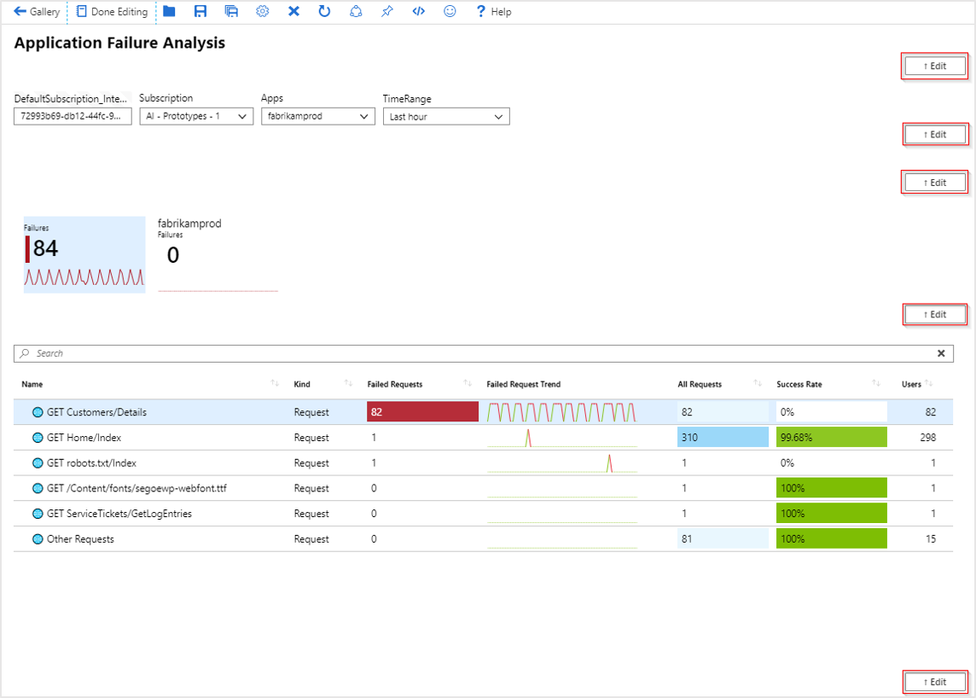
Using Azure Workbooks (2 of 2)
Exploring a workbook template
Editing workbooks

Slide 21
Azure Alerts

Slide 22
Azure Monitor Alerts
Monitor alerts offer the following benefits:
Better notification system
A unified authoring experience
View Log analytics in Azure Portal
Separation of Fired Alerts and alert rules
Better workflow
Alerts can be set based on:
Metric values
Log search queries
Activity log events
Health of the underlying Azure platform
Tests for web site availability
Alert states include:
New
Acknowledged
Closed

Slide 23
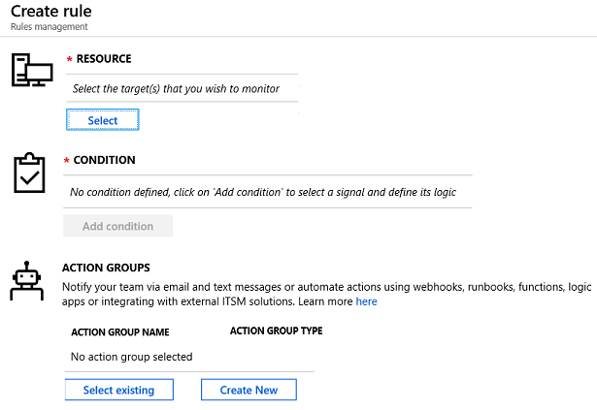
Creating Alert Rules (1 of 2)

Slide 24
Creating Alert Rules (2 of 2)
Key attributes of an alert rule include:
Target source
Signal
Criteria
Alert name
Alert description
Security
Action

Slide 25
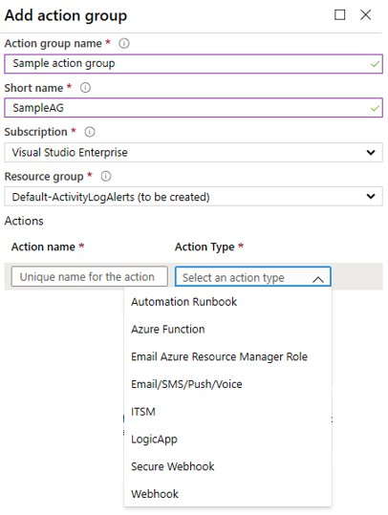
Action Groups
Automatic runbook
Azure Function
Email Azure Resource Manager role
Email/SMS/Push/Voice
ITSM
Logic App
Webhook

Slide 26
Demonstration: Alerts
Create an alert rule
Explore alert targets
Explore alert conditions
Explore alert details

Slide 27
Log Analytics

Slide 28
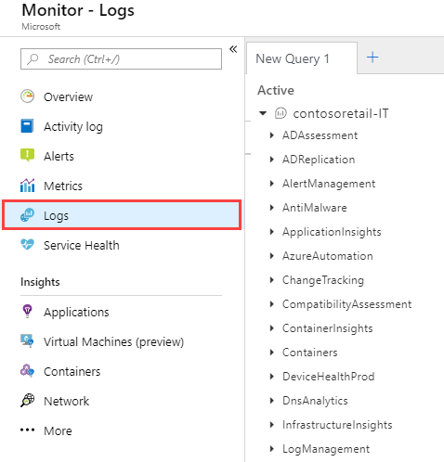
Log Analytics
Log Analytics helps collect and analyze data generated in the cloud and on-premises
Example 1 – Assessing updates
Example 2 – Change tracking

Slide 29
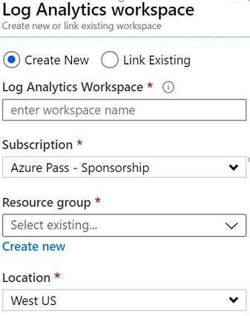
Create a Workspace
To get started with Log Analytics you need to add a workspace with the following settings:
name
subscription
resource group
Azure region
per GB pricing plan (automatically applied)

Slide 30
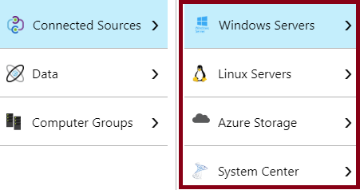
Connected Sources (1 of 2)
Connected sources are resources that generate data collected by Log Analytics

Slide 31
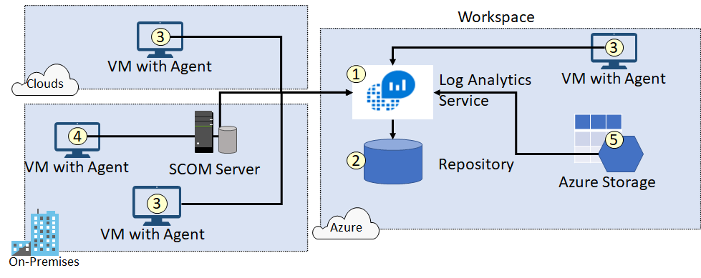
Connected Sources (2 of 2)

Slide 32
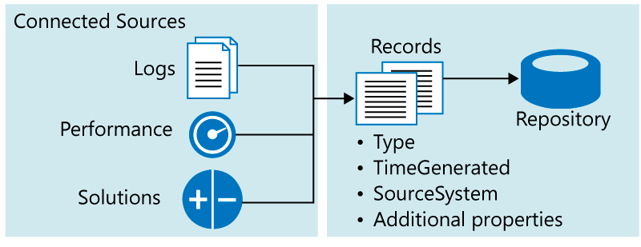
Data Sources (1 of 2)
Data sources represent data collected from connected sources

Slide 33
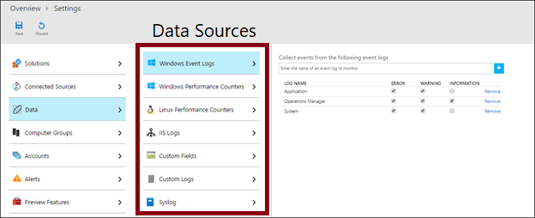
Data Sources (2 of 2)

Slide 34
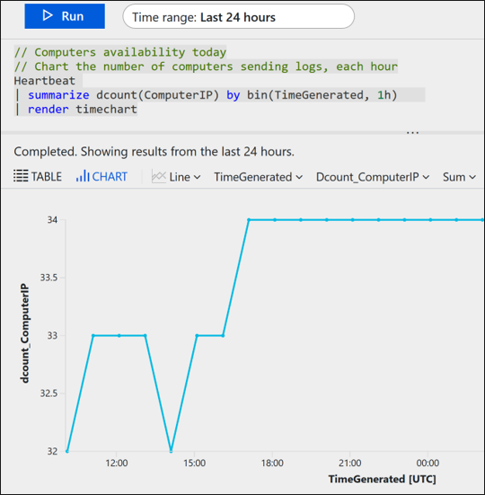
Log Analytics Querying
Log Analytics provides a query syntax to quickly retrieve and consolidate data in the repository

Slide 35
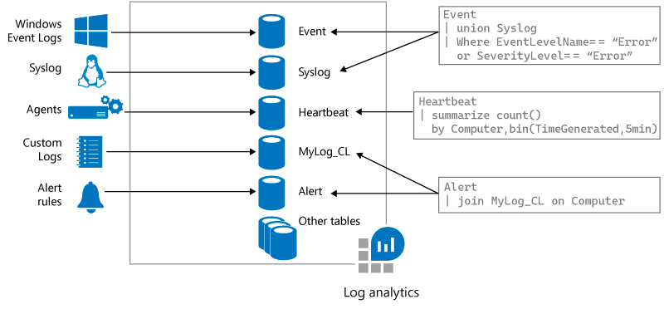
Query Language Syntax

Slide 36
Network Watcher

Slide 37
Network Watcher
Network watcher provides tools to:
Automate remote network monitoring with packet capture
Gain insight into your network traffic using flow logs
Diagnose VPN connectivity issues
The tools include:
Connection monitor: monitors communication between a virtual machine and an endpoint
Network performance monitor: helps you monitor network performance between various points in your network infrastructure, including ExpressRoute

Slide 38
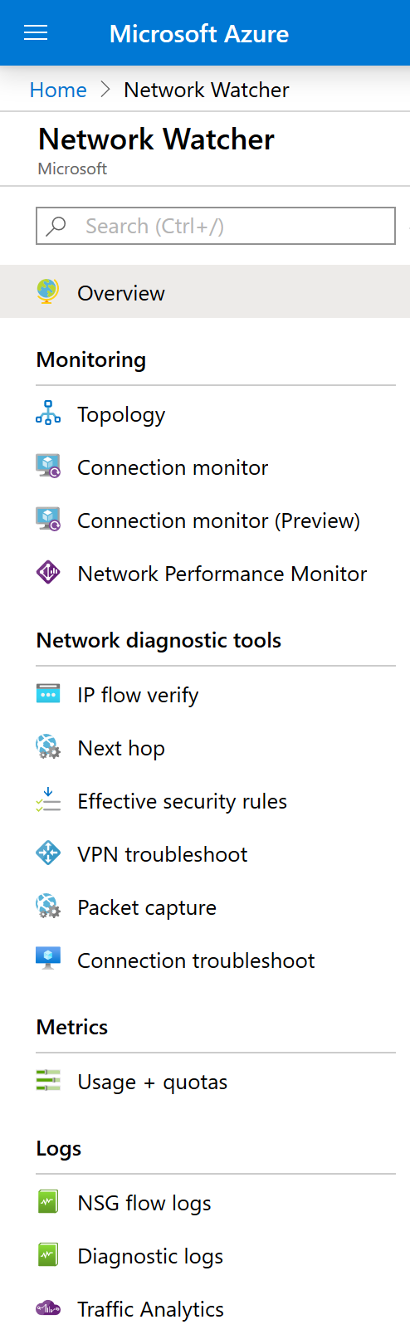
Network Watcher Diagnostics
IP flow verify
Next hop
VPN troubleshoot
NSG flow logs
Connection troubleshoot

Slide 39
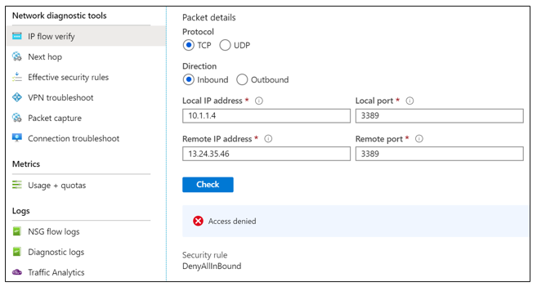
Diagnostics – IP Flow Verify
The IP flow verify tool helps diagnose connectivity issues from or to the internet and from or to on-premises environments

Slide 40
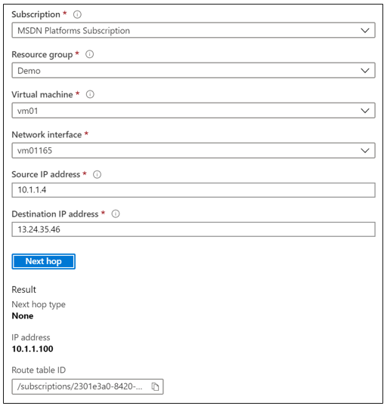
Diagnostics – Next Hop
The Next hop tool helps determine if traffic is being directed to the intended destination

Slide 41
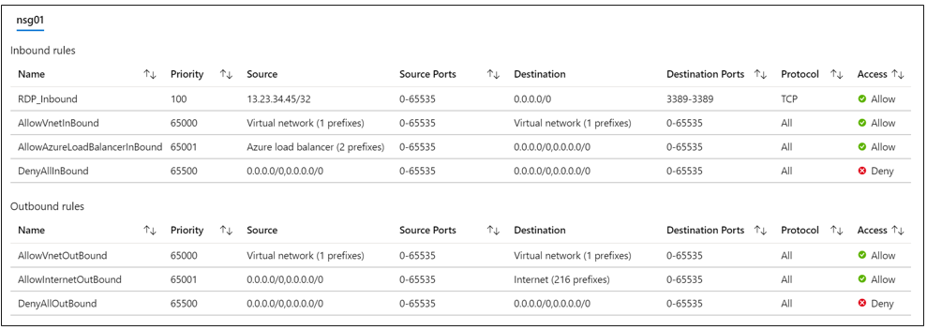
Diagnostics – Effective Security Rules
The Effective security rules tool helps examine the effective Network Security Group rules:
Priority
Source
Protocol
Action

Slide 42
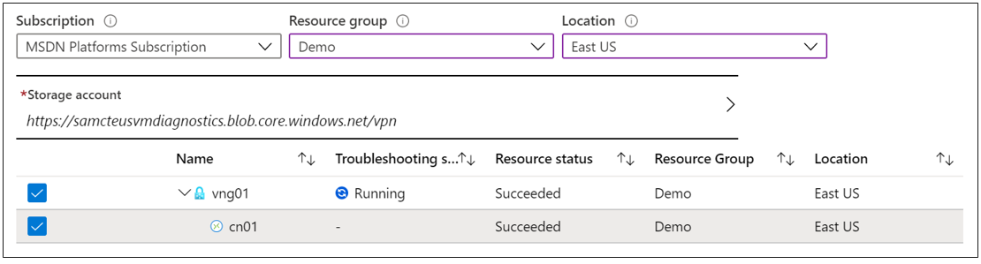
Diagnostics – VPN Troubleshooting
The VPN troubleshooting tool helps with identifying root cause of issues with VPN gateways and connection

Slide 43
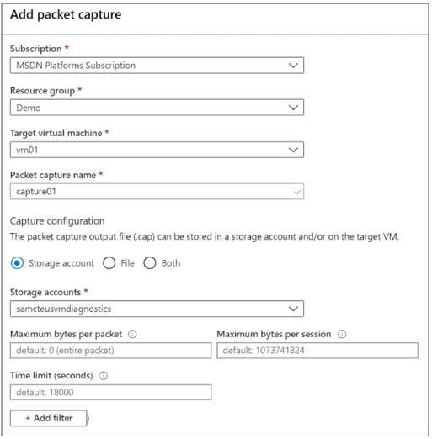
Diagnostics – Packet Capture
The Packet capture tool allows you capture traffic to and from an Azure VM

Slide 44
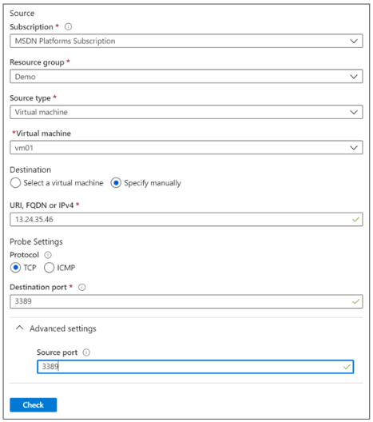
Diagnostics – Connection Troubleshoot
The Connection troubleshoot tool helps with verifying direct TCP connections from an Azure VM to an Azure VM, FQDN, URI, or IPv4 address

Slide 45
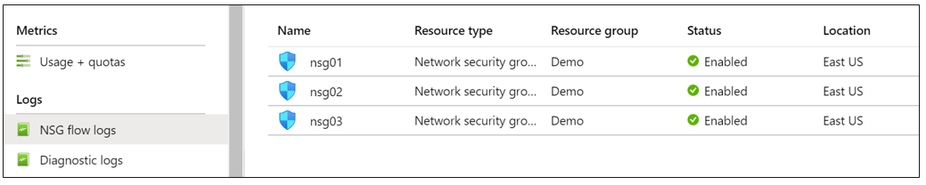
Log – NSG Flow Logs
The NSG flow logs tool allows you to view information about ingress and egress IP traffic through an NSG

Slide 46
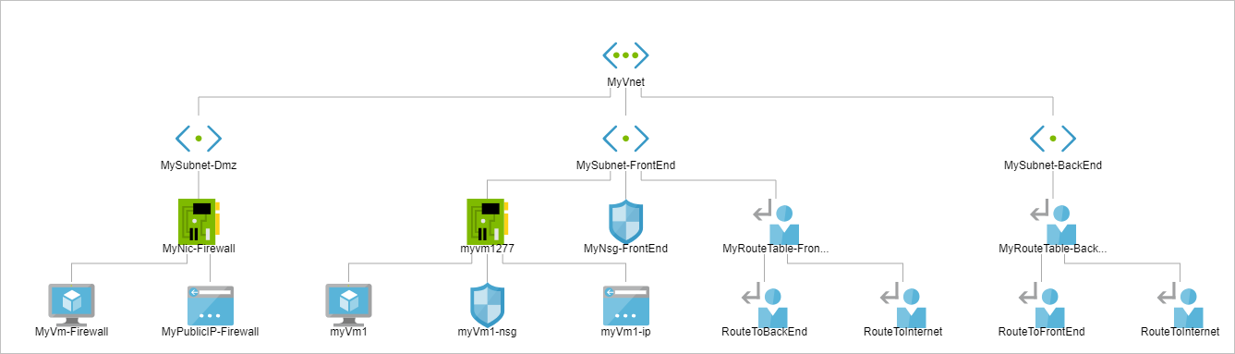
Monitoring - Topology
The Topology tool provides a visual diagram of resources within a virtual network

Slide 47
Azure Service Health

Slide 48
Azure Service Health
Azure status
Azure service health
Azure resource health

Slide 49
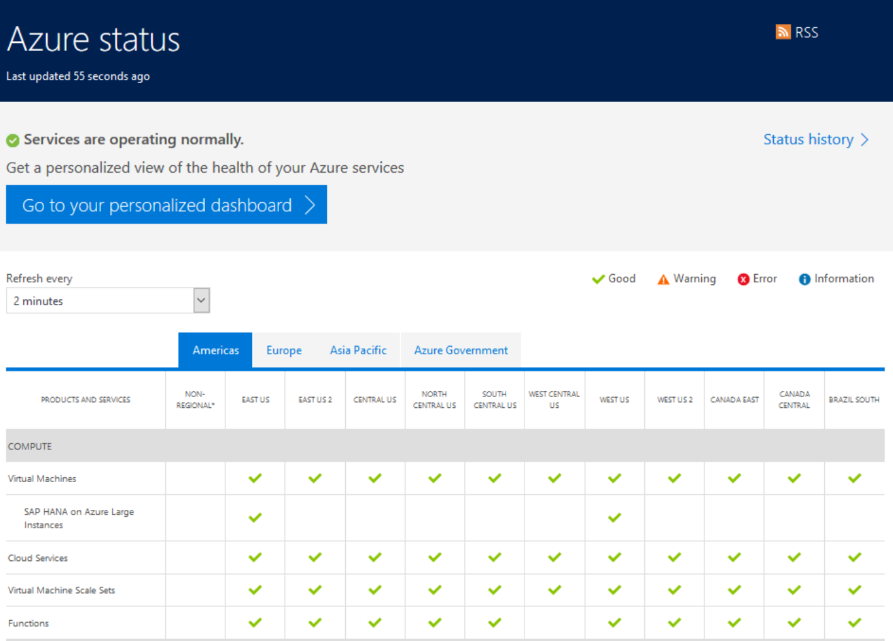
Azure Status Page
Azure status provides a global view of the health of Azure services and regions

Slide 50
Service Health Walkthrough
Service health events:
Service issues
Planned maintenance
Health advisories
Security advisories
Service Health allows you to:
See current issues which impact your services
Get links and downloadable explanations
Get support from Microsoft
Pin a personalized health map to your dashboard
Configure service health alerts

Slide 51
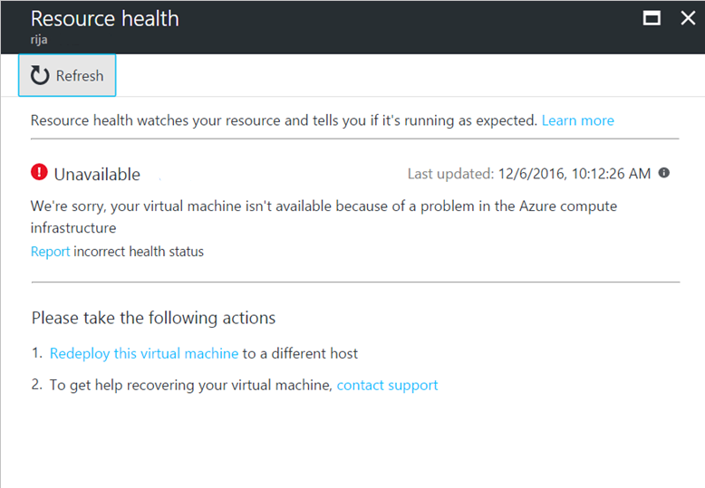
Resource Health Overview
Resource definition and health assessment
Health status
Available
Unavailable (includes platform events and non-platform events)
Unknown
Degraded
Reporting an incorrect status
History information

Slide 52
Azure Application Insights

Slide 53
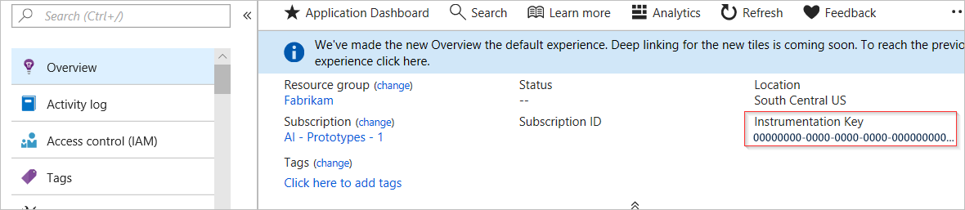
Integrate Application Insights (1 of 3)
To integrate Application Insights with your applications:
Set up Application Insights resource
Install an instrumentation package in your application. The package will monitor your application and send log data to the Log Analytics workspace.

Slide 54
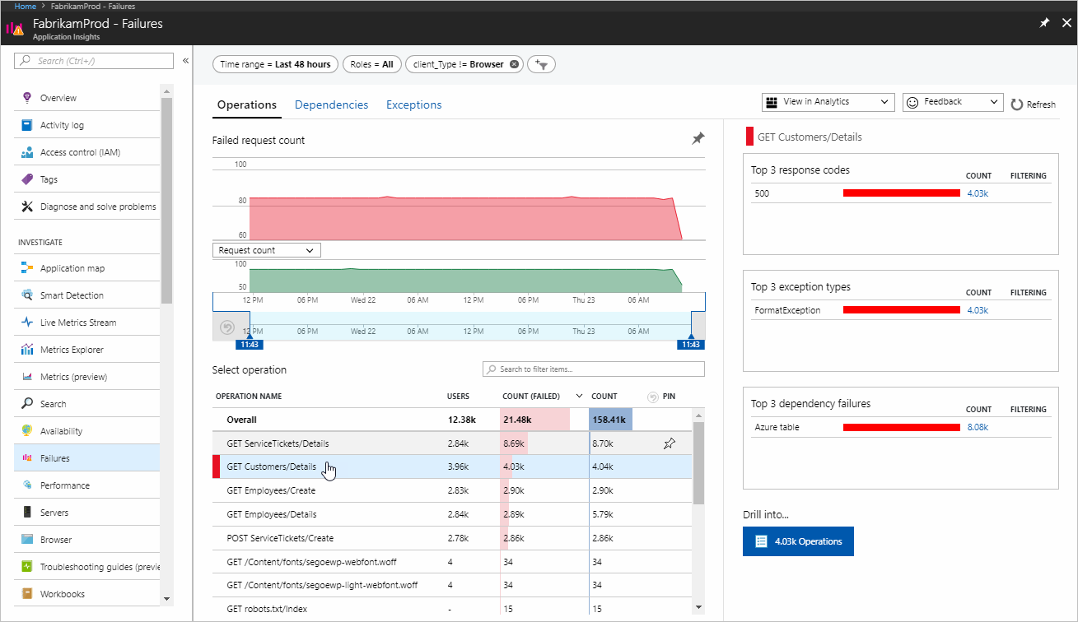
Integrate Application Insights (2 of 3)
For example, in a JavaScript web app, use a Node.js SDK as the instrumentation package.
The SDK automatically gathers data about Node.js runtime during app usage
You can view this data in the Application Insights dashboard, in the Azure portal.

Slide 55
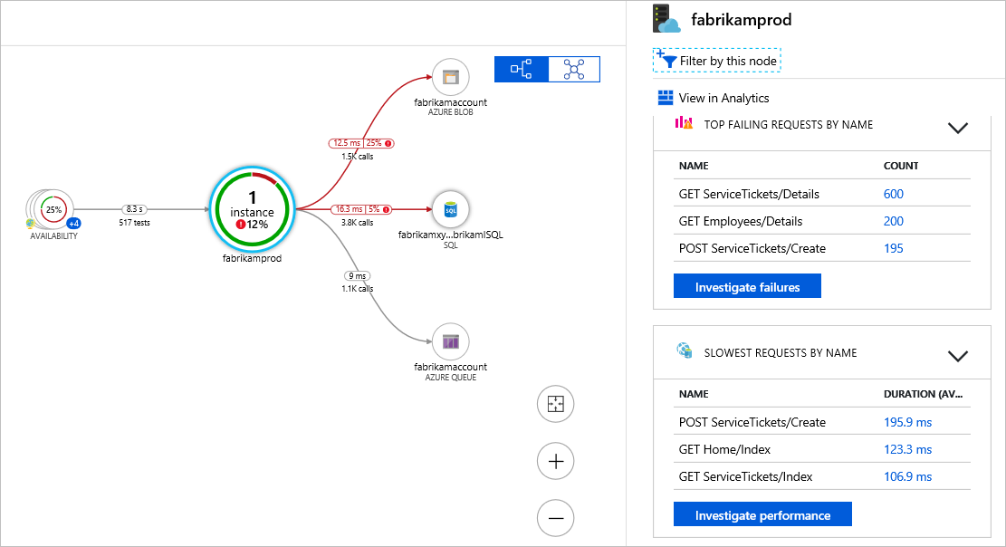
Integrate Application Insights (3 of 3)
The SDK also analyzes your application for a typology.
You can analyze this typology by reviewing the Application map view

Slide 56
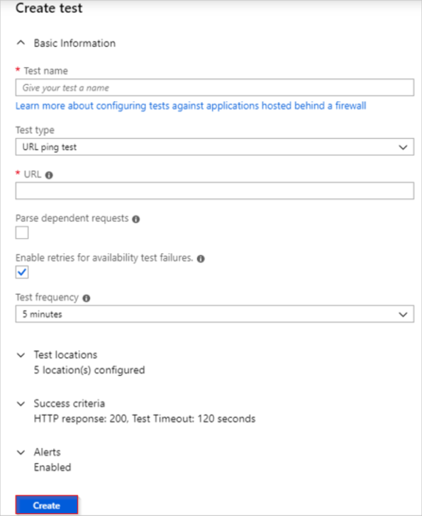
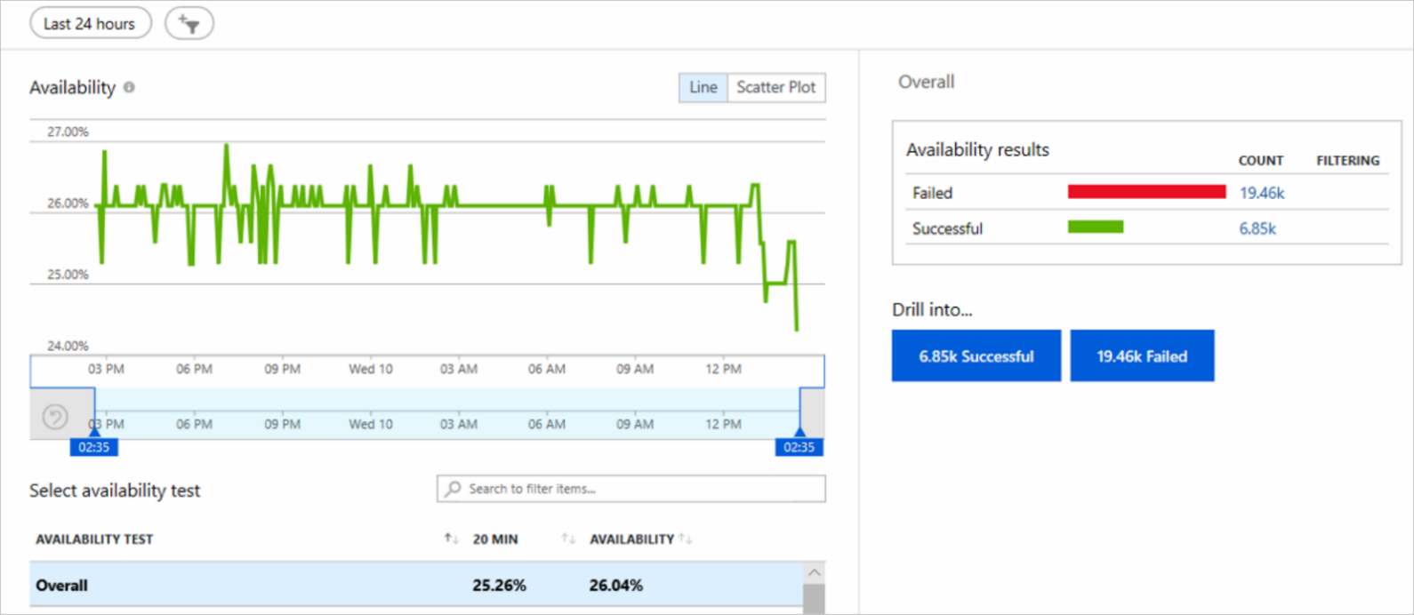
Monitor Applications Continuously
Application Insights sends automatically generated alerts
You can create availability tests to continuously monitor application health

Slide 57
Unified Monitoring in Azure

Slide 58
Unified Metrics and Logs
Azure monitor centralizes your metrics and log data from different sources

Slide 59
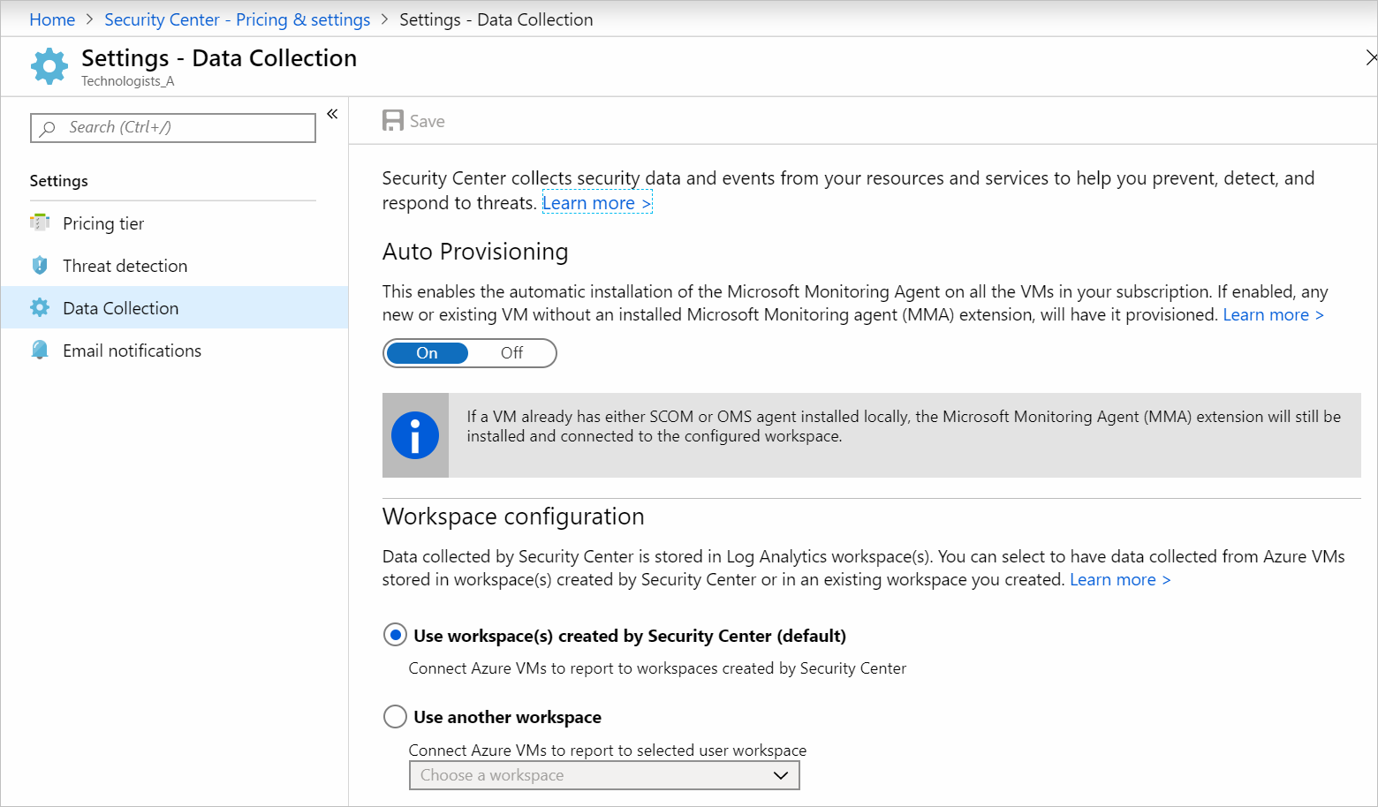
Integration with Azure Security Center
Azure Security Center collects data from resources by using Log Analytics Agent

Slide 60
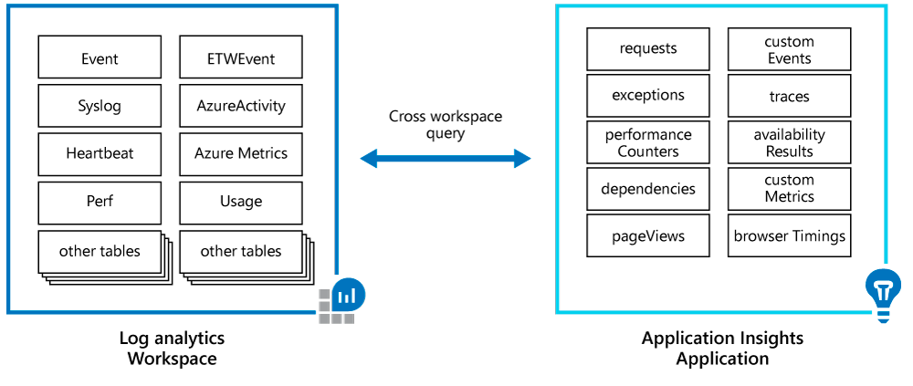
Integration with Application Insights
Azure Application Insights and Azure Monitor are integrated

Slide 61
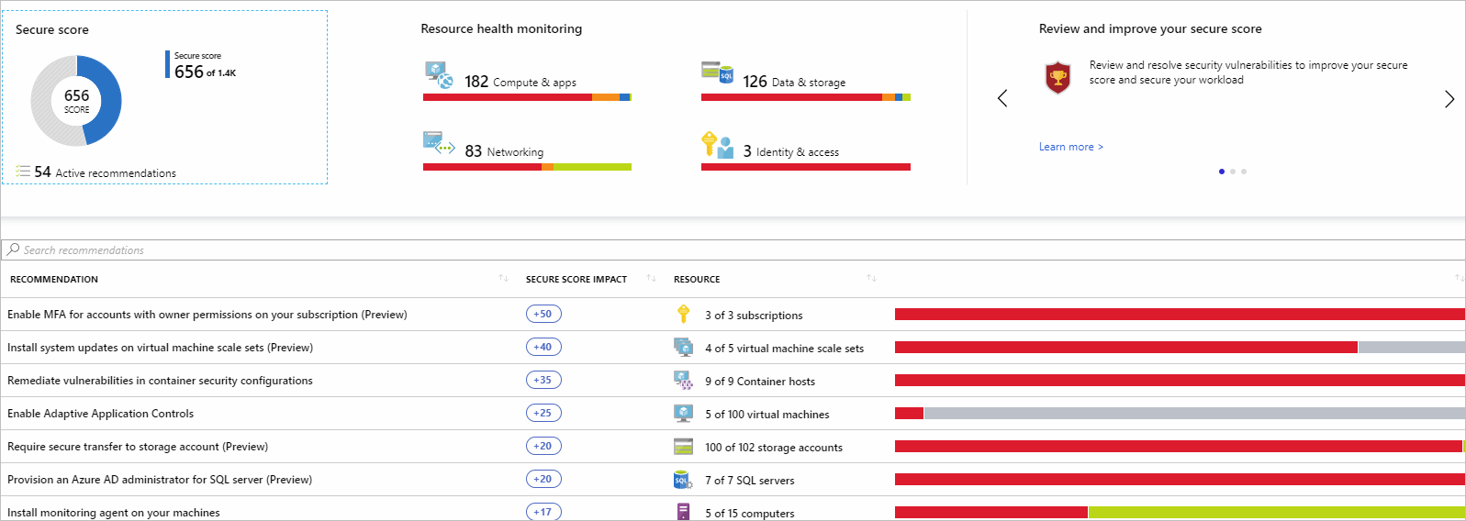
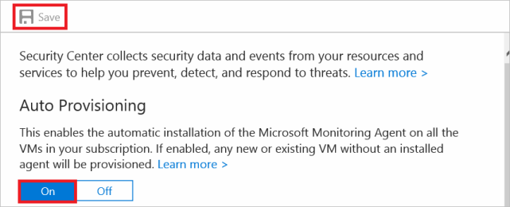
Azure Security Center
Service that manages the security of your infrastructure from a centralized location
Monitors the security of your workloads, whether they're on-premises or in the cloud
Provides you with tools that:
Monitor the health of your resources and implement recommendations.
Ease the configuration of your security.

Slide 62
Azure Security Center (1 of 3)
Azure Security Center addresses the three most urgent security challenges:
Rapidly changing workloads
Increasingly sophisticated attacks
Security skills are in short supply
Security Center provides tools to:
Strengthen security posture
Protect against threats
Get secure faster
Criteria for assessing Azure Security Center:
Identify and address risks and threats
You don’t have traditional in-house skills to secure an infrastructure
You want to secure an infrastructure consisting of on-premises and cloud resources

Slide 63
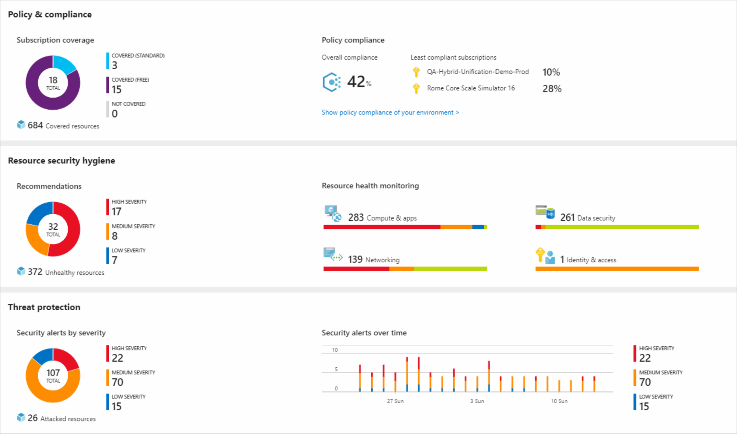
Azure Security Center (2 of 3)
Understand the security posture of your architecture:

Slide 64
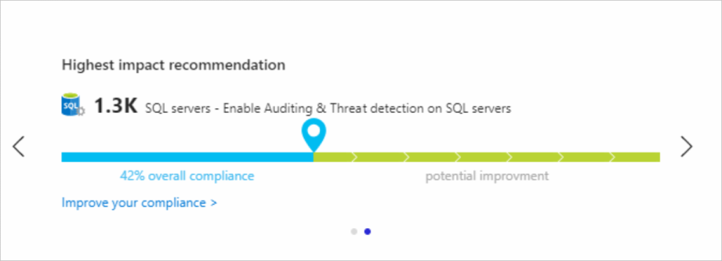
Azure Security Center (3 of 3)
Understand the security posture of your architecture:

Slide 65
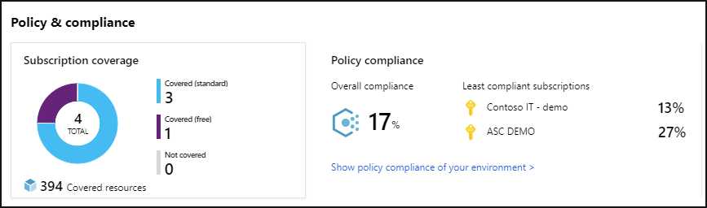
Strengthened Security Posture (1 of 4)
Policy and compliance

Slide 66
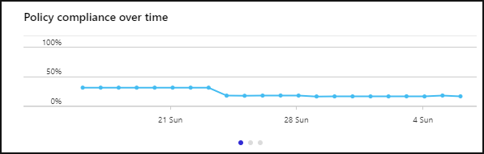
Strengthened Security Posture (2 of 4)
Policy compliance over time

Slide 67
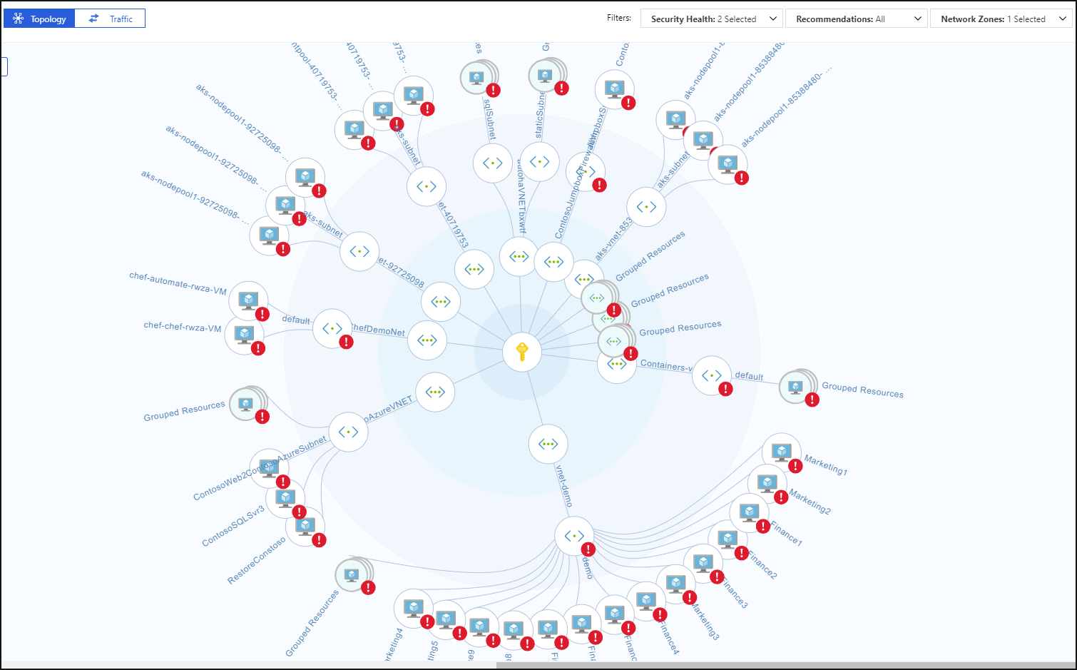
Strengthened Security Posture (3 of 4)
Continuous assessments (network map)

Slide 68
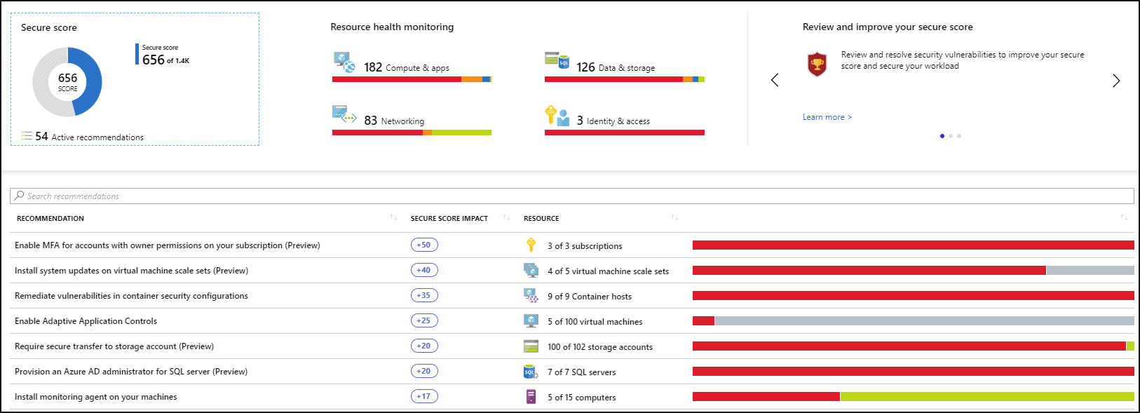
Strengthened Security Posture (4 of 4)
Secure score

Slide 69
Protect Against Threats with Azure Security Center
Security Center gives a centralized view of all security alerts

Slide 70
Monitor Azure Costs

Slide 71
Cost Trade-offs
Consider these trade-offs between cost optimization and other aspects of design, such as security, scalability, resilience, and operability. An optimal design is not synonymous with a low-cost design. Low cost may incur additional risk.
Cost versus reliability
Cost versus performance efficiency
Cost versus security
Cost versus operation excellence
Does the cost of high-availability components exceed the acceptable downtime?
Factors impacting performance:
Fixed or consumption-based provisioning
Azure regions
Caching
Batch or real-time processing
Increasing security of the workload will increase cost. For example, for specific security and compliance requirements, deploying to differentiated regions will be more expensive. Premium security features can also increase the cost.
Investing in systems monitoring and automation might increase the cost initially, but over time will reduce cost.

Slide 72
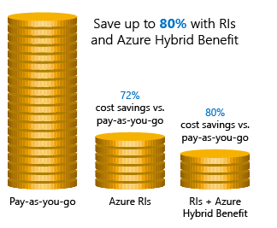
Cost Savings
Azure Reservations: helps you save money by pre-paying for services.
Azure Hybrid Benefits: use Windows Server and SQL Server on-premises licenses with Software Assurance.
Azure Credits: monthly credit benefit that allows you to experiment with, develop, and test new solutions on Azure.
Regions: choose low-cost locations and regions.
Notes:
Cost savings - https://docs.microsoft.com/en-us/learn/modules/predict-costs-and-optimize-spending/4-save-on-infrastructure-costs
Instructor Note: you may want to navigate to the Cost savings page with students https://azure.microsoft.com/en-us/overview/azure-vs-aws/cost-savings/
Azure V AWS Cost Savings
Azure Reservations compares with AWS RI (Reserved Instances)
Azure Hybrid Benefits – AWS License Manager and BYOL (Bring your own Licenses)
Azure Credits is monthly Azure credit for Visual Studio subscribers – no direct comparison
Azure Regions compares with AWS Regions – both vary in price by region selected

Slide 73
Report on Spend
Azure provides tools to create cost reports:
Azure Advisor Cost Analysis tool: provides a view of spending over a period to help understand trends.
Azure Advisor recommendations: highlights over-provisioned services and recommends ways to lower costs.
Consumption APIs: provided by Azure so you can write custom tools and scripts to track costs over time.
Power BI Desktop: connects to billing data from Azure Cost Management.

Slide 74
Monitoring Azure Costs
Identify stakeholders
Determine frequency
Responding to cost alerts
Define budgets
Gather information
Azure Cost Management – Cost Analysis
Azure Cost Management – Advisor

Slide 75
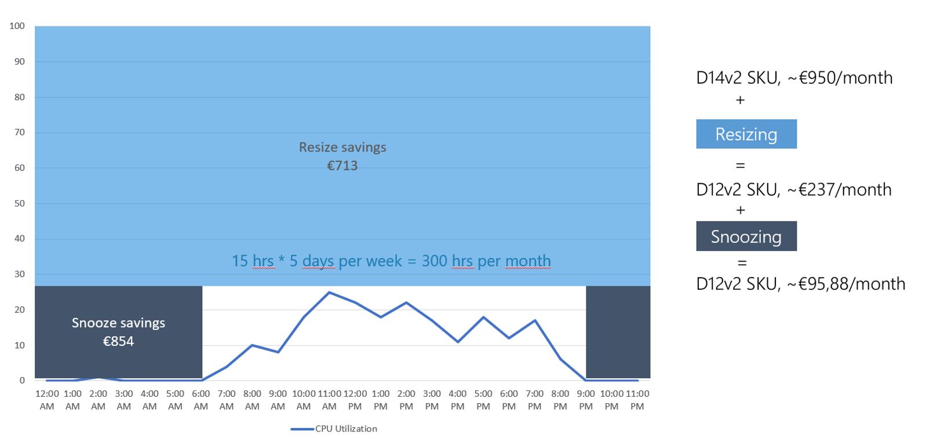
Optimizing Azure Costs (1 of 2)

Slide 76
Optimizing Azure Costs (2 of 2)
Consider the following methods of managing pricing:
Enterprise agreement
Enterprise Dev Test Subscription
Cloud Service Provider (Partner program)
Azure Hybrid Use Benefit
Azure Reserved Instances

Slide 77
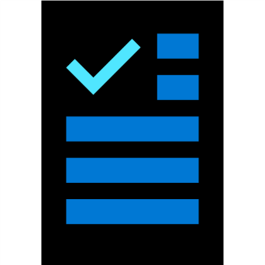
Module Review Questions

